Slide 1
Today’s Agenda
Writing a Boolean expression from truth table as sum of minterms or product of maxterms.

Slide 2
Representation Conversion
Circuit
Boolean
Expression
Truth
Table

Slide 3
Writing of Boolean Expression from Truth Table.
There are two methods to write a Boolean expression from truth table.
Sum of Products (SOP) form/ Sum of minterms
Product of Sums (POS) form / product of maxterms

Slide 4
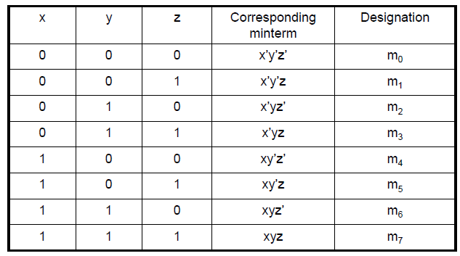
Minterms
A minterm is AND term of variables where each variable appears once either in orignal form or its complement form.
If there are ‘n’ variables in a Boolean expression then there will be 2^{n} minterms.
Consider a case when n=3

Slide 5
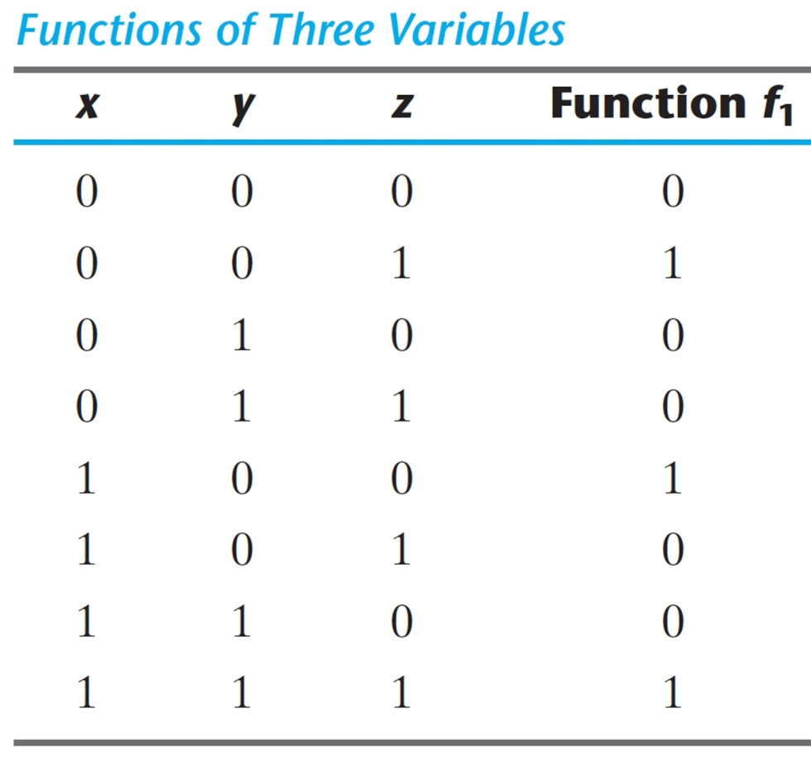
Writing a Boolean Expression as SOP/Sum of minterms from Truth Table:
A Boolean function can be expressed algebraically from a given truth table by:
  Forming a minterm for each combination of the variables that produces a ‘1’ in the function
  Taking the OR of all those terms
Example
f₁ =
x’y’z
+
xy’z’
+
xyz

Slide 6
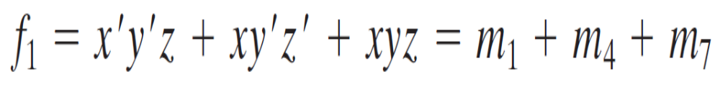
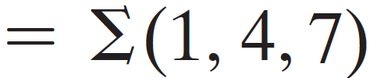
Contd…
Sum of Minterms
Any Boolean function can be expressed as a sum of minterms

Slide 7
Complement in SOP(minterms) Form
Compliment of a Function: from a given truth table by:
  Forming a minterm for each combination that produces a ‘0’ in the function and ORing those terms
Example

Slide 8

Writing a Boolean Expression as SOP/Sum of minterms from Truth Table:
x
0
0
0
0
1
1
1
1
y
0
0
1
1
0
0
1
1
z
0
1
0
1
0
1
0
1
F₁
0
1
0
0
1
0
0
1
F₁’
1
0
1
1
0
1
1
0

Slide 9
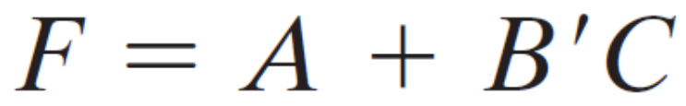
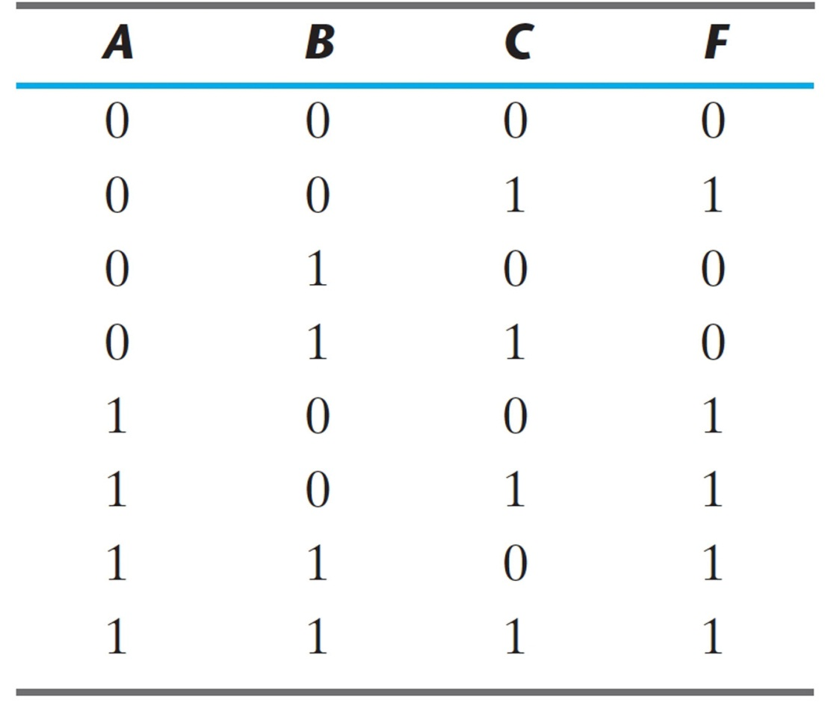
Example
Express the Boolean function as a Sum of minterms:
Method 1

Slide 10
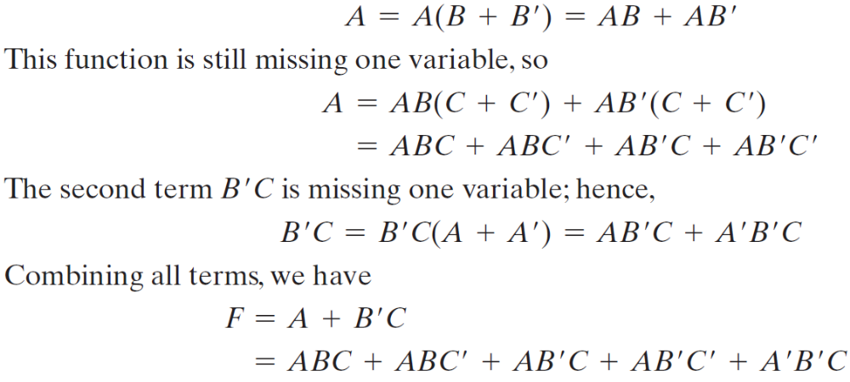
Example
Express the Boolean function as a Sum of minterms:
Using Boolean Algebra
  The function has three variables: A, B, and C
  The first term A is missing two variables (B and C)
  The second term is missing one variable (A)
  Recall: Multiplicative identity = 1 or (x + x’)
Method 2

Slide 11
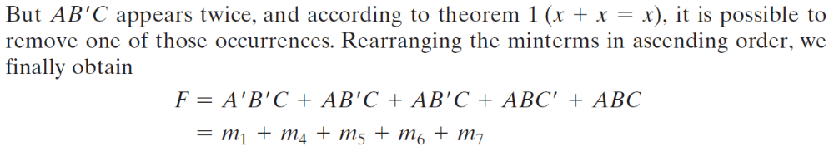
Example
Method 2

Slide 12
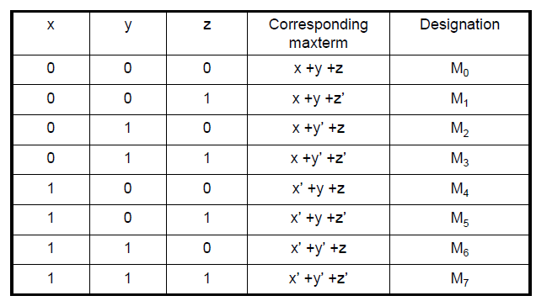
Maxterms
A maxterm is ORED term of variables where each variable appears once either in orignal form or its complement form.
If there are ‘n’ variables in a Boolean expression then there will be 2^{n} maxterms.
Consider a case when n=3

Slide 13

Writing a Boolean Expression as POS/Product of maxterms from Truth Table:
A Boolean function can be expressed algebraically as product of maxterms from a given truth table directly by forming a maxterm for each combination of variables that produces ‘0’ in the function and then ANDing all those terms.
x
0
0
0
0
1
1
1
1
y
0
0
1
1
0
0
1
1
z
0
1
0
1
0
1
0
1
F₁
0
1
0
0
1
0
0
1
F₂
0
0
0
1
0
1
1
1
F₂=(x+y+z)(x+y+z’)(x+y’+z)(x’+y+z)
F₂= M₀ . M₁ . M₂ .M₄

Slide 14
Converting a Boolean Expression into POS/ Product of maxterms
Express the function or expression into ORed terms using Boolean algebra rule A + BC = (A + B)(A + C) : for instance
x + yz = (x+y)(x+z)
Then any missing variable x in each OR term is ORed with xx’

Slide 15
Example:
F = xy + x’z

